Slide 1
Module 1: Introduction
JVA-083

Slide 2
Agenda
Introduction
Asynchronous messages passing
Build your own Kafka Get to know all most important features/behaviour
CLI tools and Web UI Interact with Kafka without programming
Java Client API Use Kafka client library to create fundamental messaging patterns
AVRO + Schema Registry Why is managing message formats crucial in any Kafka enabled project?
Spring for Kafka Make Kafka programming fun and professional
Kafka Streams An introduction to event streaming world

Slide 3
Prerequisites
Introduction
IntelliJ IDEA (preferably Ultimate)
HTTP Client (IDEA Ultimate, Postman, curl)
Java 17-19
Podman (ASL license) / Docker (only for participants with commercial license)

Slide 4
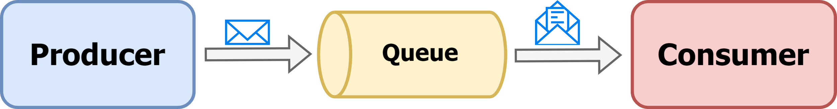
Asynchronous message passing
Introduction
Asynchronous message passing is a messaging model where messages are sent and received independently of time, meaning the sender does not wait for an immediate response from the receiver. Instead, the sender continues its processing, and the receiver handles the message when it's ready.

Slide 5
Asynchronous message passing
Introduction
Advantages
Loose coupling Asynchronous messaging decouples the sender and receiver, as they don't need to be aware of each other's state or availability in real-time. This loose coupling makes it easier to modify or replace components without affecting the overall system.
Improved Responsiveness Asynchronous messaging allows systems to remain responsive even when handling time-consuming tasks. The sender can continue processing other tasks while waiting for a response, ensuring that the system doesn't block.
Scalability Asynchronous systems can handle a large number of concurrent requests more efficiently than synchronous systems. This scalability is essential for applications with varying workloads or high traffic.

Slide 6
Asynchronous message passing
Introduction
Advantages
Enhanced Availability Systems that use asynchronous messaging can be designed to have higher availability since components can continue processing even if some parts of the system are temporarily unavailable
Buffering Messages can be buffered in a queue until the receiver is ready to process them. This feature helps manage bursts of incoming requests without overwhelming the system and allows for smoother handling of traffic spikes.

Slide 7
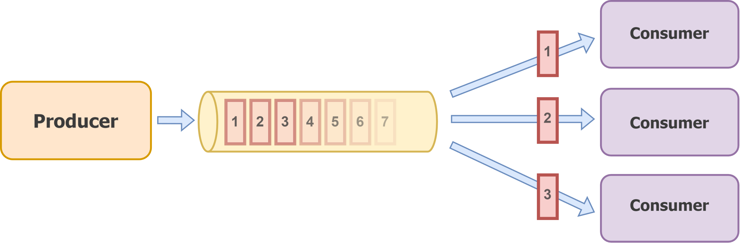
Point-to-point messaging model
Introduction

Slide 8
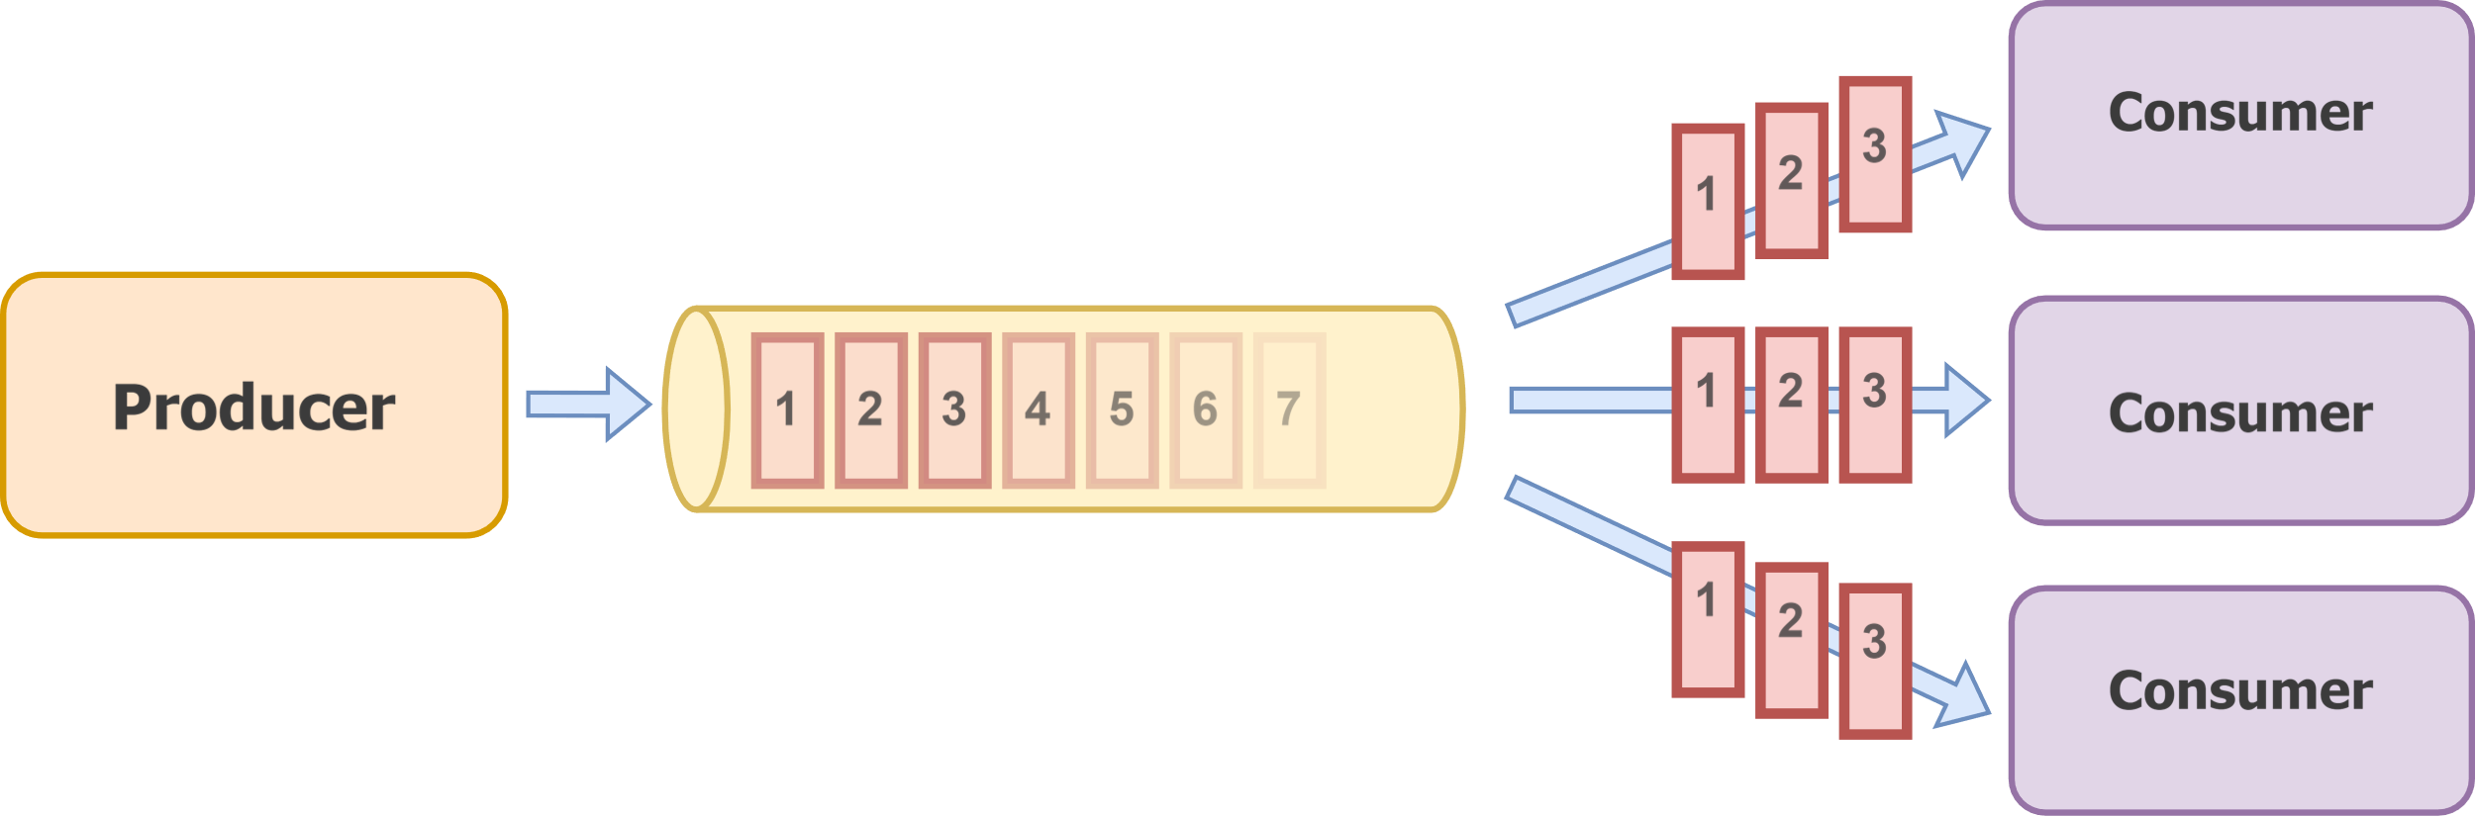
Publish/subscribe messaging model
Introduction

Slide 9
Build your own Kafka

Slide 10
Let’s specify some requirements
Introduction
Let’s build a message broker
We do not know how many producers there will be
We will have multiple consumers fetching messages for various different purposes
We expect A LOT of traffic
The consumers will be mainly interested in reading data in sequential way
The consumers might be concerned about reading data in the same order it was produced
We need the product to scale well
We need the product to be durable and resilient

Slide 11
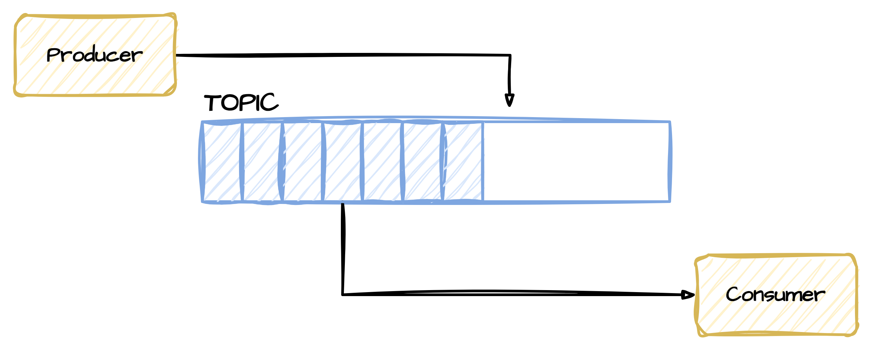
Producer > file > consumer
Introduction

Slide 12
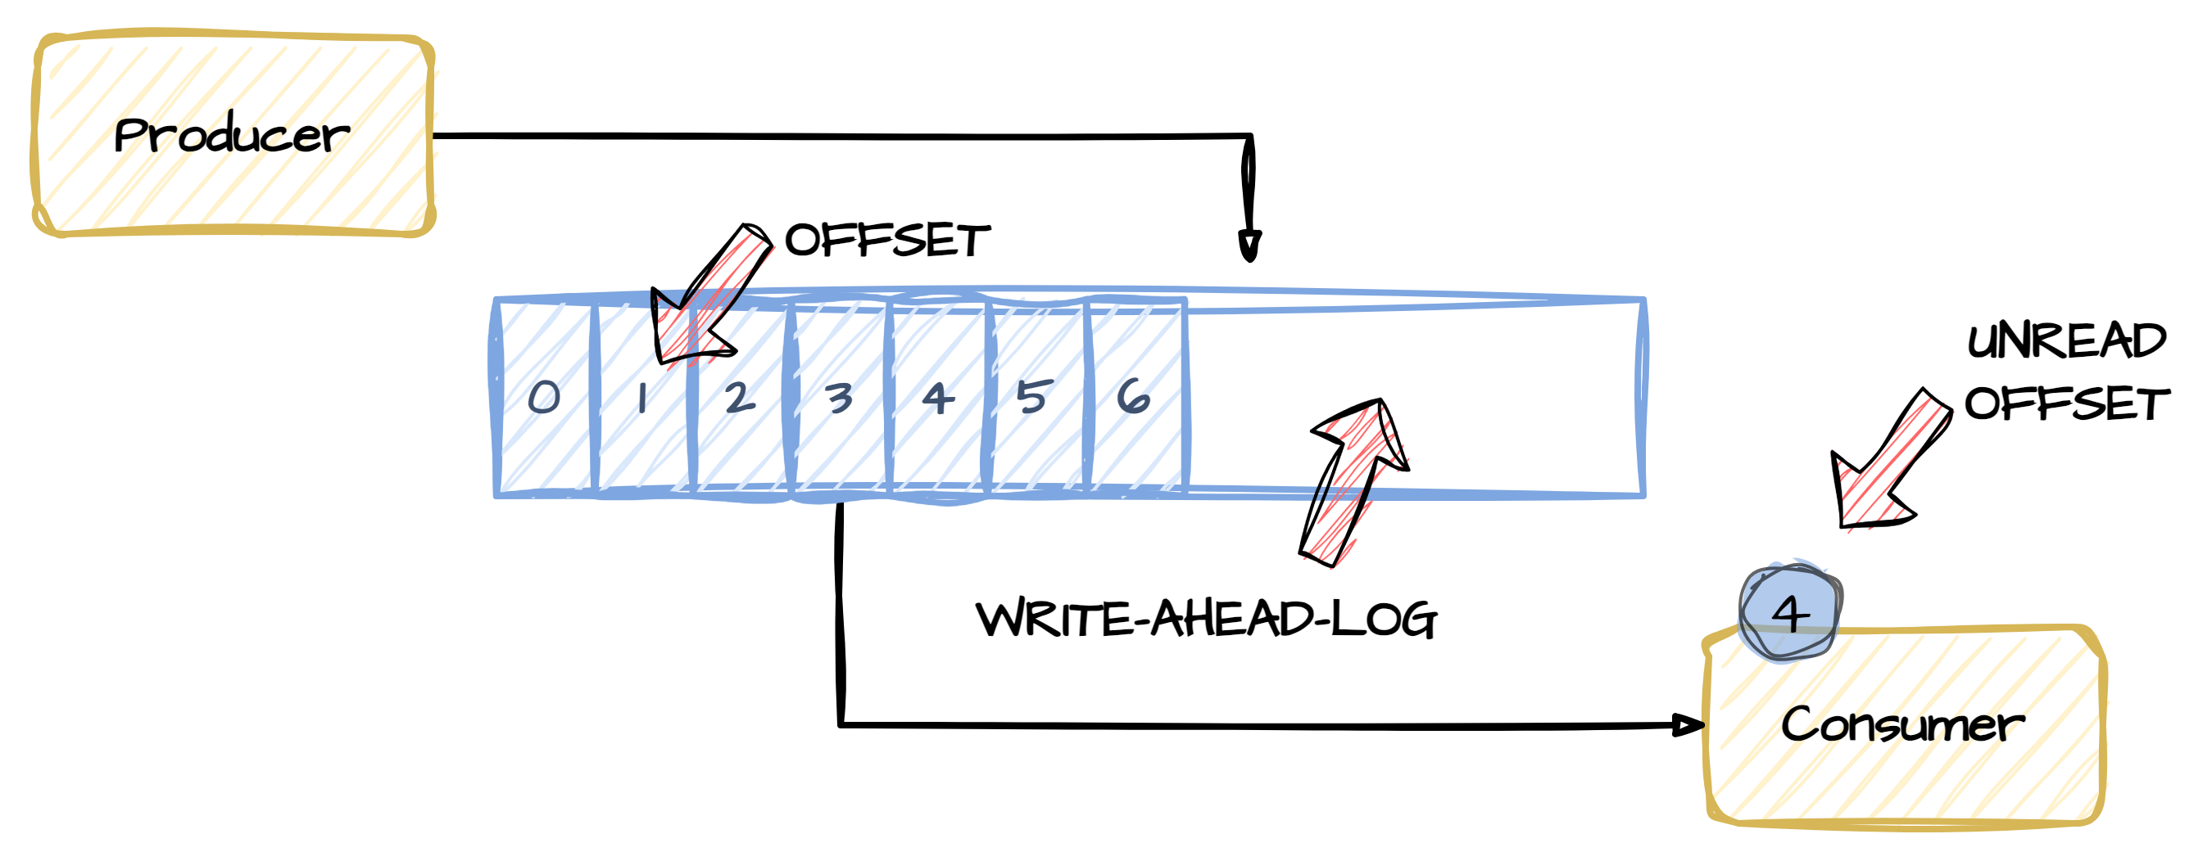
We need to keep track of processing position
Introduction

Slide 13
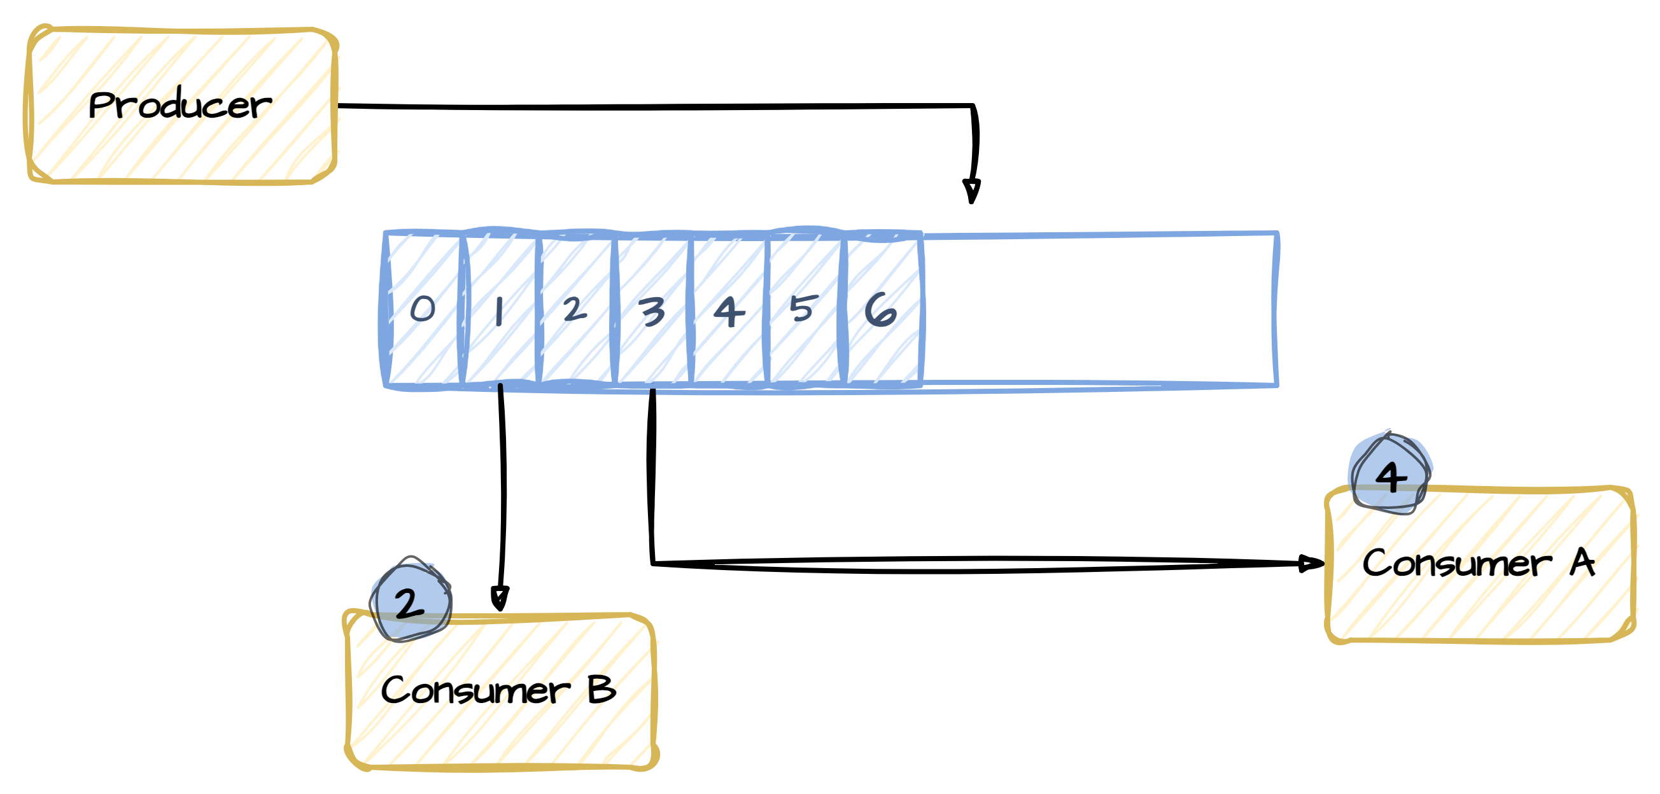
Publish/subscribe model implemented
Introduction

Slide 14
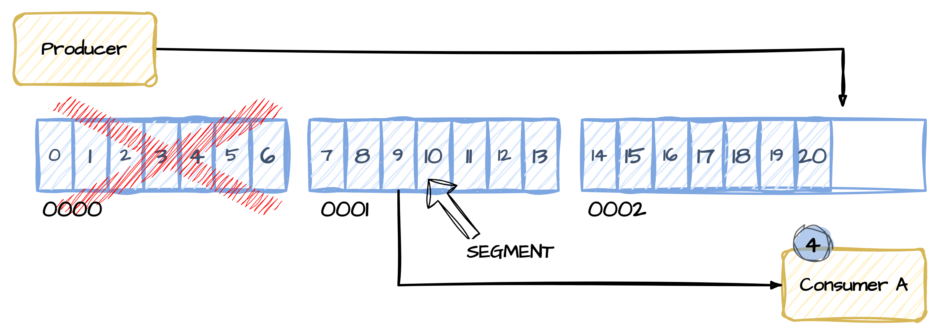
We need to delete data eventually
Introduction

Slide 15
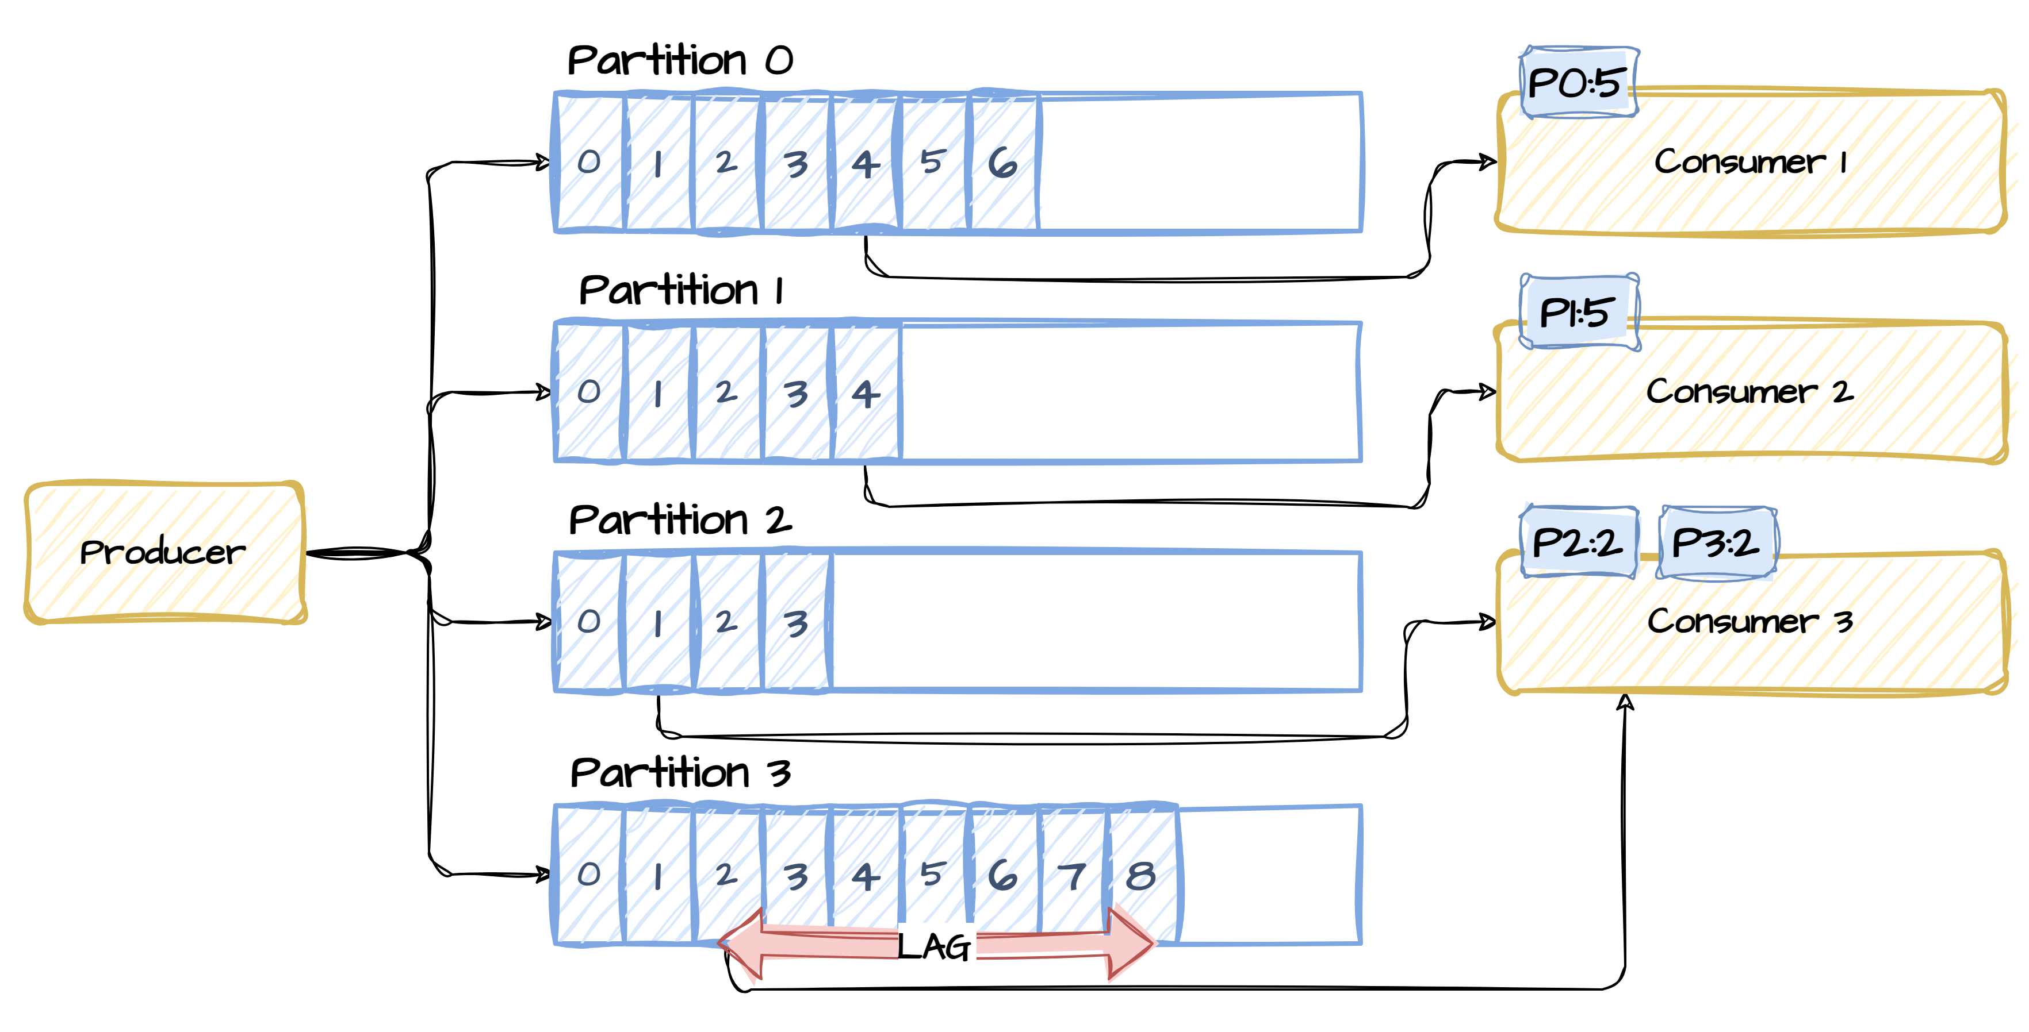
Point-to-point model
Introduction
Introducing partitions

Slide 16
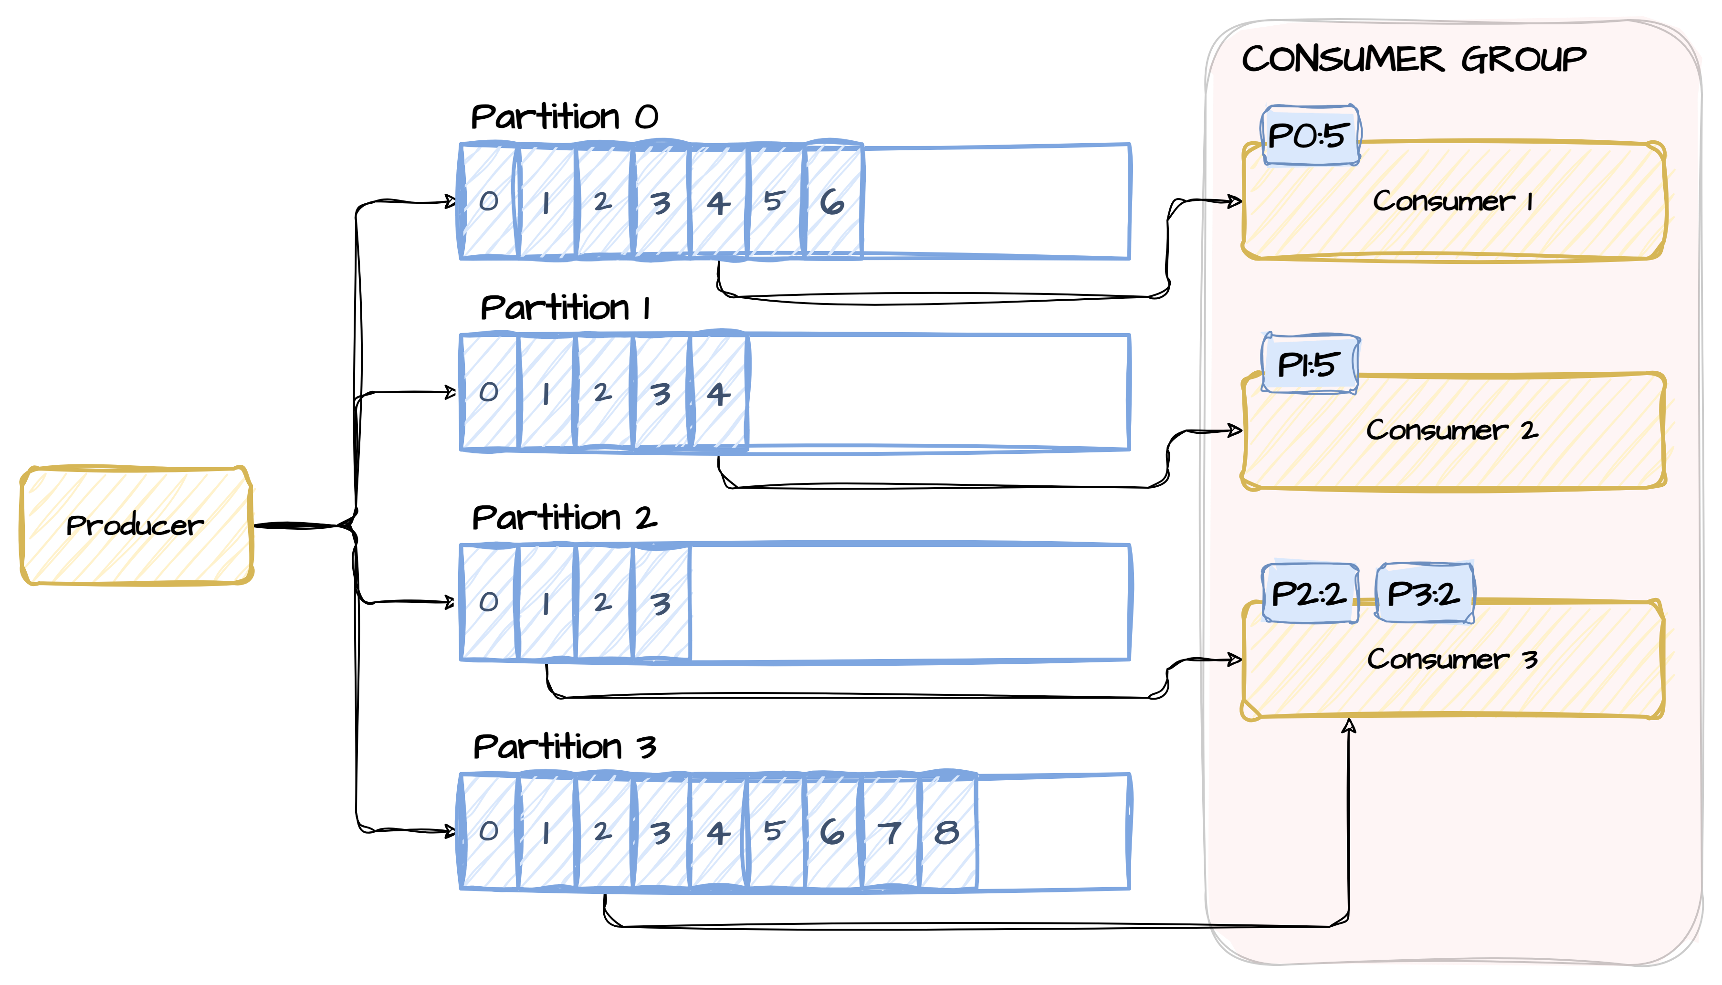
Consumer group
Introduction

Slide 17
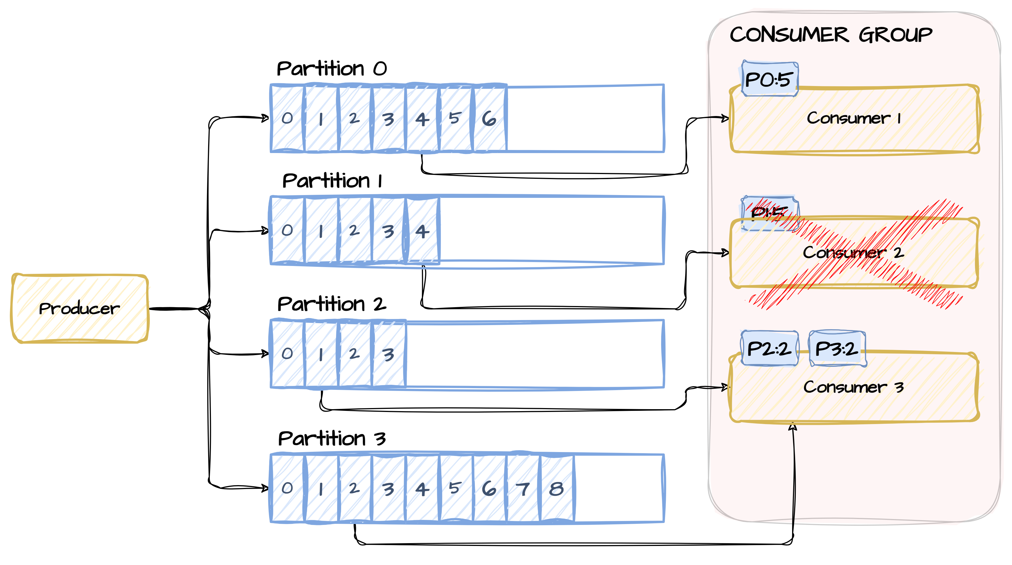
Handling consumer failures
Introduction

Slide 18
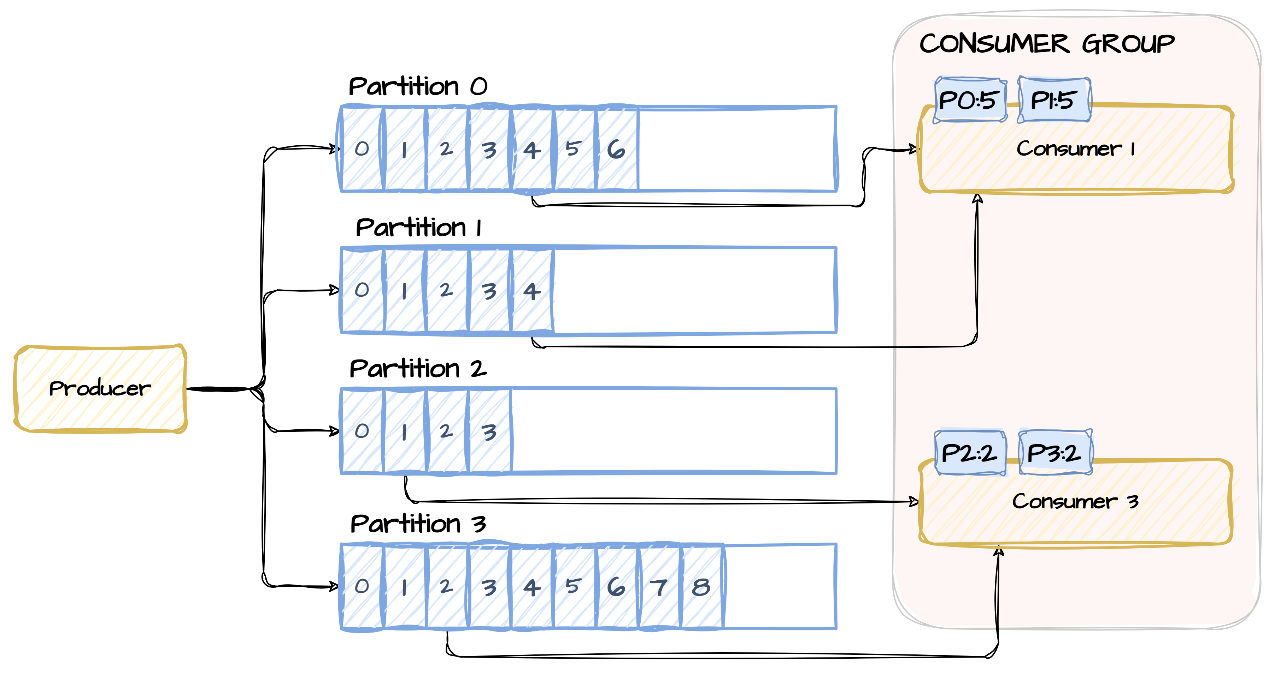
Rebalance process
Introduction

Slide 19
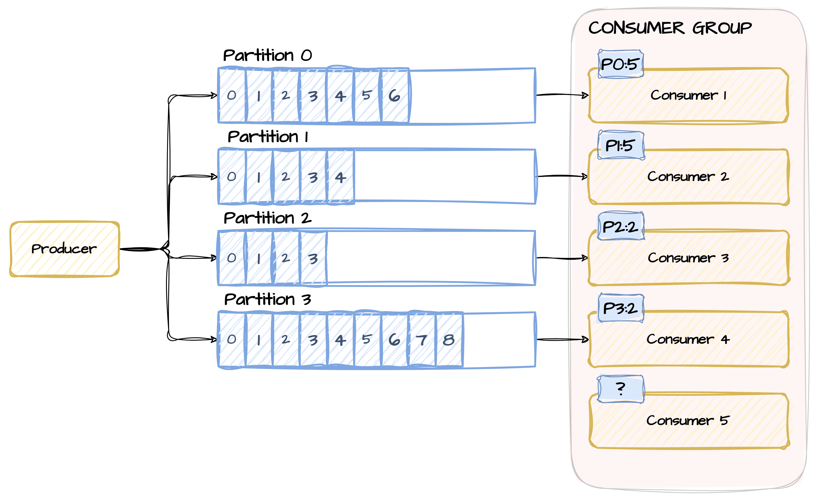
What if we have too many consumers?
Introduction

Slide 20
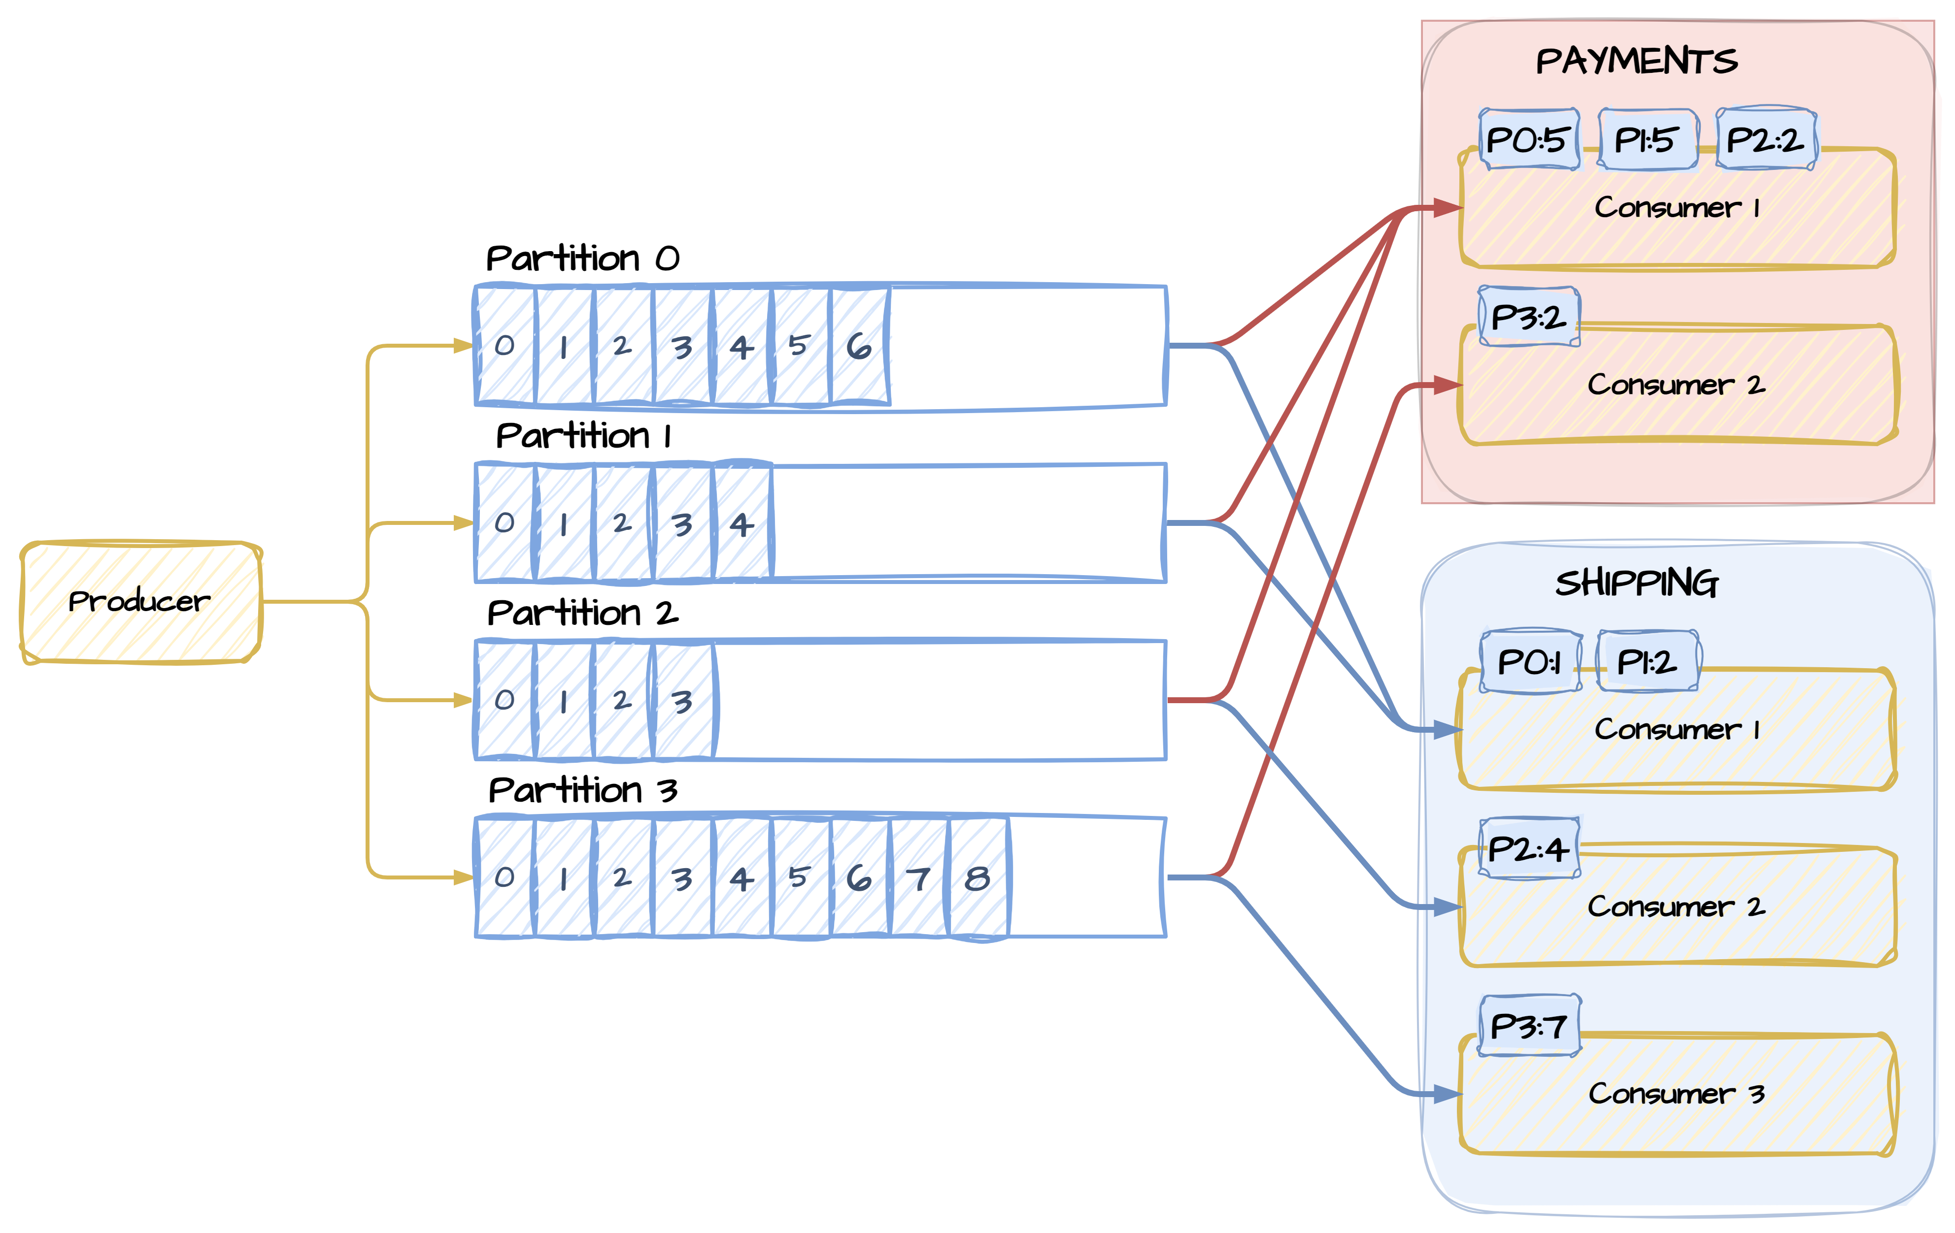
If Kafka does not delete data right away…
Introduction
We can create multiple consumer groups!

Slide 21
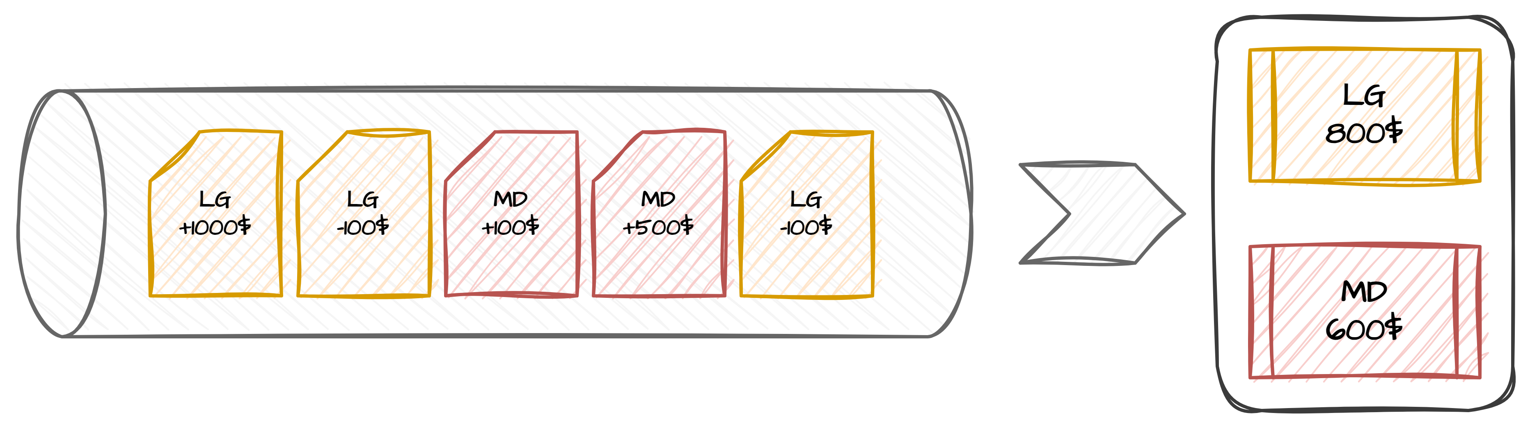
Stateful processing
Introduction
…or stateless but retaining message order

Slide 22
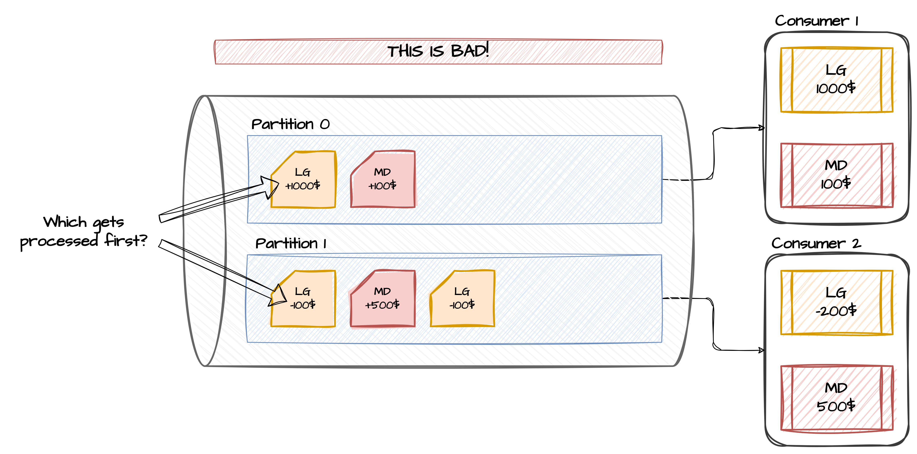
Stateful processing
Introduction

Slide 23
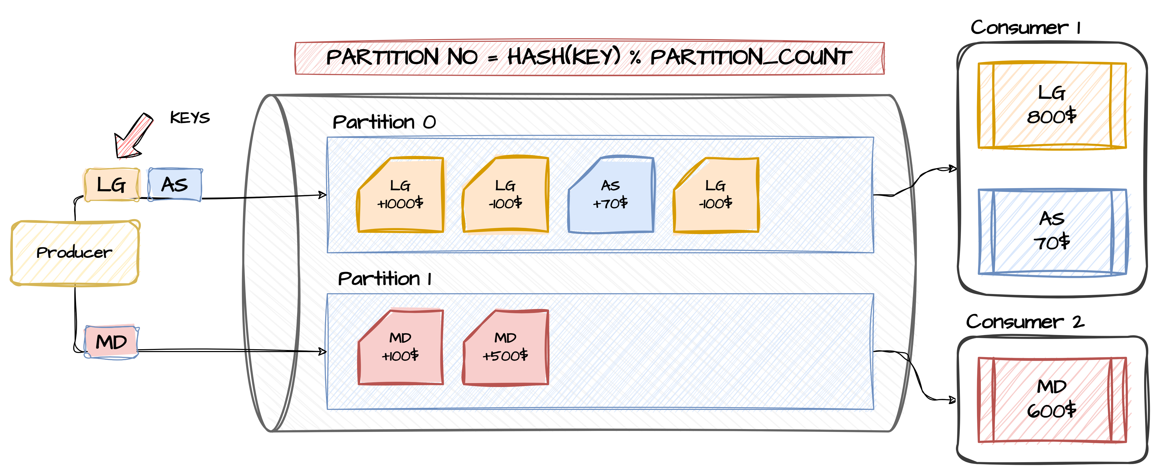
Stateful processing
Introduction

Slide 24
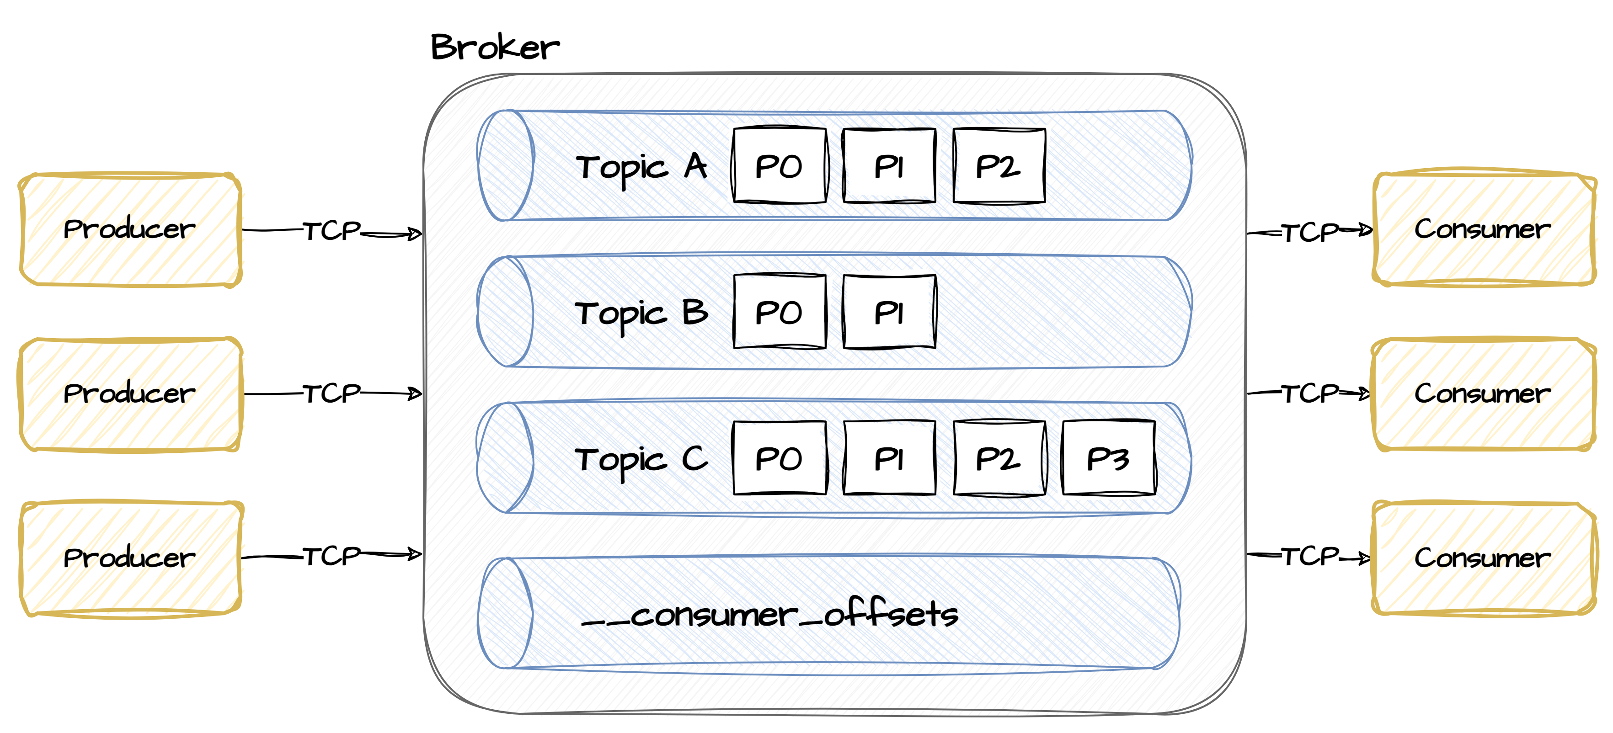
Multiple producers
Introduction

Slide 25
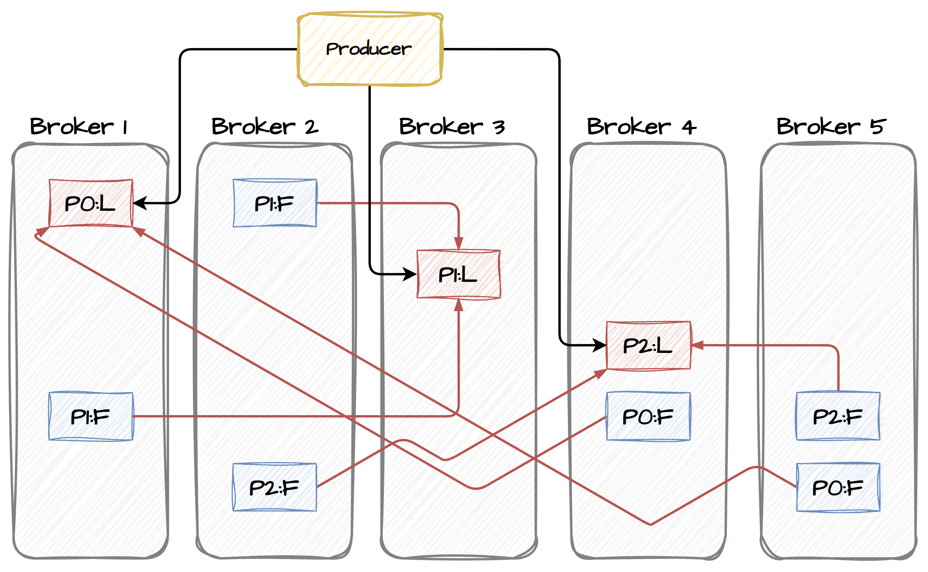
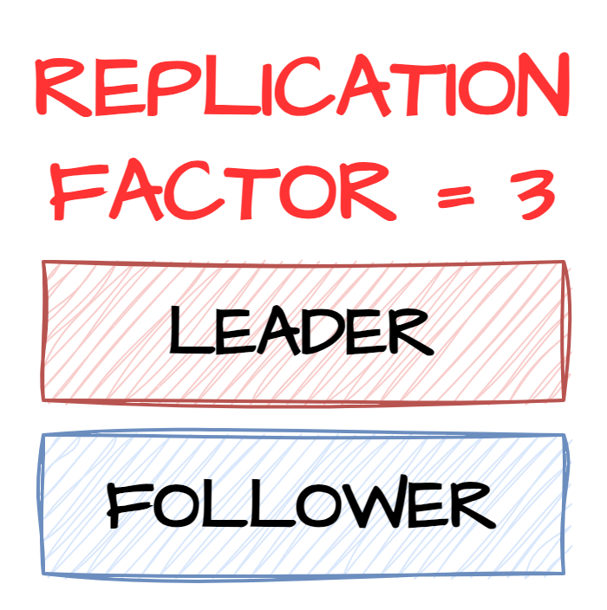
Resillency
Introduction

Slide 26
Infra setup

Slide 27
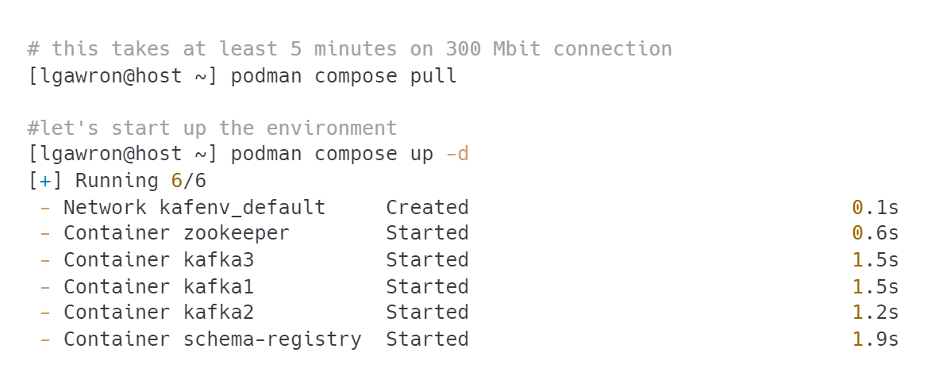
Starting up Kafka
Introduction
Let’s use containers
TIP: you need to run those commands in <projectdir>/_cluster directory. This is where the docker-compose.yml file is.

Slide 28
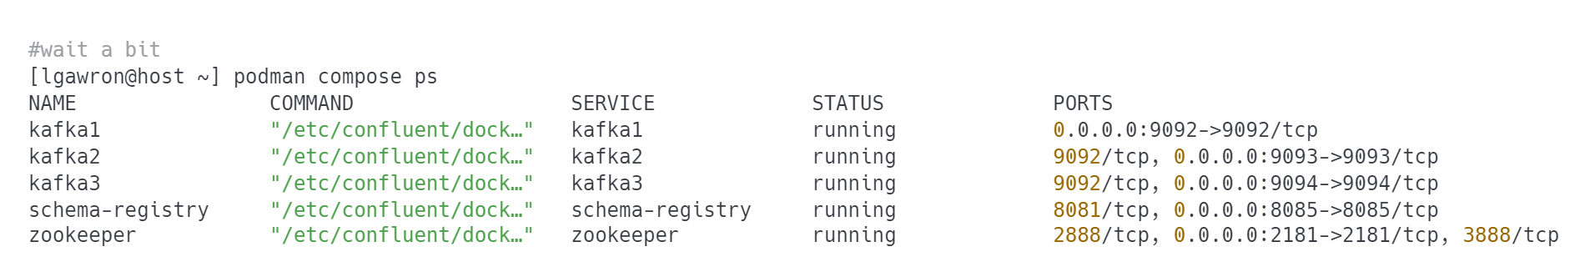
Check the result
Introduction

Slide 29
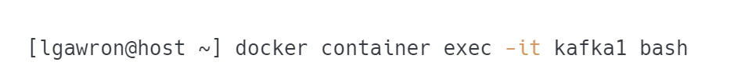
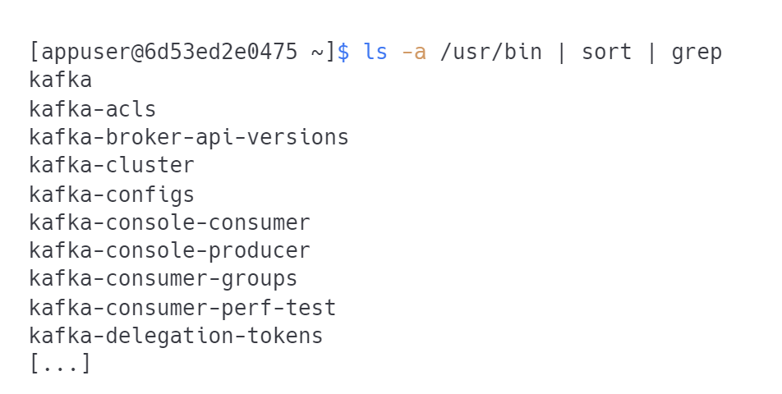
Where are my Kafka tools?
Introduction
Inside the Kafka container…

Slide 30
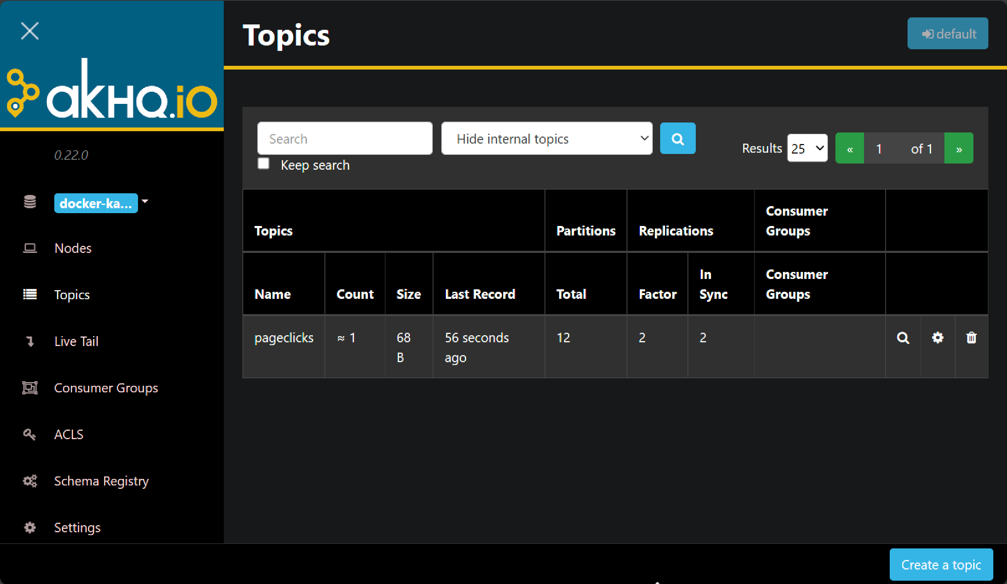
Is there a Kafka management UI?
Introduction
Kafka by itself does not provide one. We will be using an external open source product called AKHQ
NOTE: Expect a plethora of different UIs on different projects.

Slide 31


Questions?
31

Slide 32
Thank you!
Please share your feedback. Your opinion is important to us!

